Slide 1
Amazon Web Services(AWS)
By Mahesh

Slide 2
AWS Overview
In 2006, Amazon Web Services (AWS) began offering IT infrastructure services to businesses as web services—now commonly known as cloud computing.
Amazon Web Services offers a broad set of global cloud-based products, over 140 AWS services are available.
AWS provides a highly reliable, scalable, low-cost infrastructure platform in the cloud that powers hundreds of thousands of businesses in 190 countries around the world.

Slide 3
What is Cloud Computing?
Cloud computing is the on-demand delivery of compute power, database storage, applications, and other IT resources through a cloud services platform via the Internet with pay-as-you-go pricing.
You can access as many resources as you need, almost instantly, and only pay for what you use.
A cloud services platform such as Amazon Web Services owns and maintains the network-connected hardware required for these application services, while you provision and use what you need via a web application.

Slide 4
Advantages of Cloud Computing
Trade capital expense for variable expense
Stop guessing capacity
Increase speed and agility
Stop spending money running and maintaining data centers
Go global in minutes

Slide 5
Types of Cloud Computing Models
Infrastructure as a Service (IaaS)
Infrastructure as a Service provides you with the highest level of flexibility and management control over your IT resources and is most similar to existing IT resources that many IT departments and developers are familiar with today.
Examples: DigitalOcean, Rackspace, Amazon Web Services (AWS), Microsoft Azure, Google Compute Engine (GCE)
Platform as a Service (PaaS)
Platforms as a service remove the need for organizations to manage the underlying infrastructure (usually hardware and operating systems) and allow you to focus on the deployment and management of your applications.
Examples: AWS Elastic Beanstalk, Windows Azure, Google App Engine
Software as a Service (SaaS):
Software as a Service provides you with a completed product that is run and managed by the service provider. In most cases, people referring to Software as a Service are referring to end-user applications.
Examples: Google Apps, Dropbox, Salesforce, Cisco WebEx, Concur, GoToMeeting

Slide 6
Cloud Computing Deployment Models
On-premises:
Deploying resources on-premises, using virtualization and resource management tools, is sometimes called “private cloud”. On-premises deployment does not provide many of the benefits of cloud computing but is sometimes sought for its ability to provide dedicated resources.
Cloud:
A cloud-based application is fully deployed in the cloud and all parts of the application run in the cloud
Hybrid:
A hybrid deployment is a way to connect infrastructure and applications between cloud-based resources and existing resources that are not located in the cloud.

Slide 7
AWS Global Infrastructure
The AWS Cloud infrastructure is built around AWS Regions and Availability Zones. An AWS Region is a physical location in the world where we have multiple Availability Zones.
Availability Zones consist of one or more discrete data centers, each with redundant power, networking, and connectivity, housed in separate facilities.
The AWS Cloud operates in over 60 Availability Zones within over 20 geographic Regions around the world, with announced plans for more Availability Zones and Regions.

Slide 8
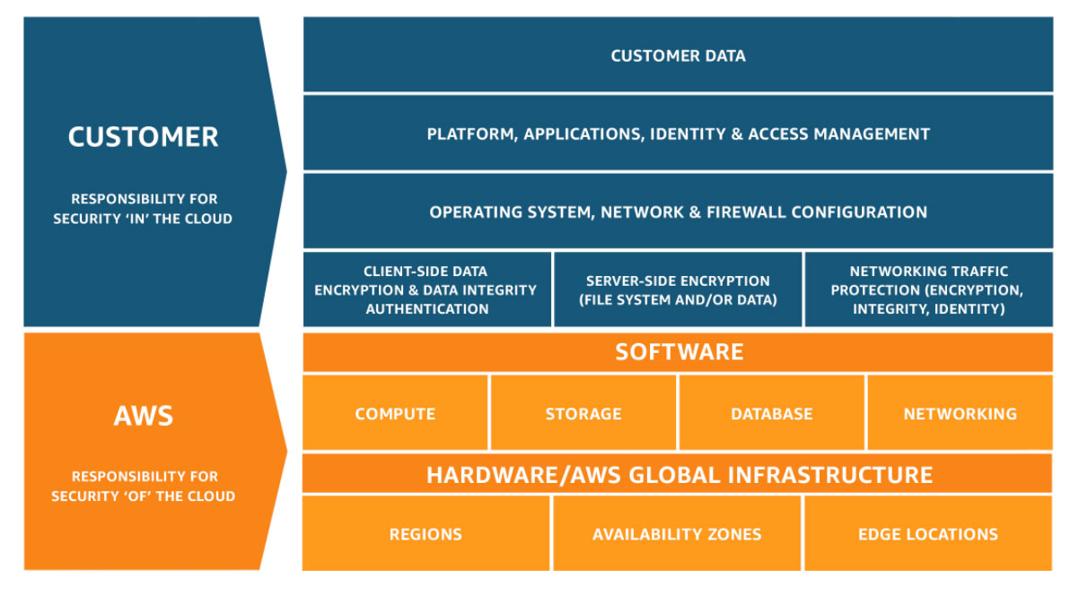
Shared Responsibility Model

Slide 9
Security and Compliance
The IT infrastructure that AWS provides to its customers is designed and managed in alignment with best security practices and a variety of IT security standards. The following is a partial list of assurance programs with which AWS complies:
SOC 1/ISAE 3402, SOC 2, SOC 3
FISMA, DIACAP, and FedRAMP
PCI DSS Level 1
ISO 9001, ISO 27001, ISO 27017, ISO 27018
For more: https://aws.amazon.com/compliance/programs/

